Slide 1
Choosing a Software License

Slide 2
Picking a license
Use a common license
Check with your sponsor or institution
Consider discipline-specific license
Which license allows a wide audience and range of uses?

Slide 3
The Licenses
 | GNU GPL | Apache 2.0 | Modified BSD | MIT License | CC0
License type | Copyleft | Permissive | Permissive | Permissive | Public Domain Dedication
Source Code | Must be open | Doesn’t have to be open | Doesn’t have to be open | Doesn’t have to be open | Doesn’t not specify
Re-licensing | Derivative work must be GNU GPL | Derivative work can be released under another license or as proprietary software | Derivative work can be released under another license or as proprietary software | Derivative work can be released under another license or as proprietary software | Derivative work can be released under another license or as proprietary software
Commercial Use | Permitted | Permitted | Permitted | Permitted | Permitted
License and copyright notice | Must be preserved | Must be preserved | Must be preserved | Must be preserved | Does not need to be preserved

Slide 4
The Licenses
 | GNU GPL | Apache 2.0 | Modified BSD | MIT License | CC0
License type | Copyleft | Permissive | Permissive | Permissive | Public Domain Dedication
Source Code | Must be open | Doesn’t have to be open | Doesn’t have to be open | Doesn’t have to be open | Doesn’t not specify
Re-licensing | Derivative work must be GNU GPL | Derivative work can be released under another license or as proprietary software | Derivative work can be released under another license or as proprietary software | Derivative work can be released under another license or as proprietary software | Derivative work can be released under another license or as proprietary software
Commercial Use | Permitted | Permitted | Permitted | Permitted | Permitted
License and copyright notice | Must be preserved | Must be preserved | Must be preserved | Must be preserved | Does not need to be preserved

Slide 5
The Licenses
 | GNU GPL | Apache 2.0 | Modified BSD | MIT License | CC0
License type | Copyleft | Permissive | Permissive | Permissive | Public Domain Dedication
Source Code | Must be open | Doesn’t have to be open | Doesn’t have to be open | Doesn’t have to be open | Doesn’t not specify
Re-licensing | Derivative work must be GNU GPL | Derivative work can be released under another license or as proprietary software | Derivative work can be released under another license or as proprietary software | Derivative work can be released under another license or as proprietary software | Derivative work can be released under another license or as proprietary software
Commercial Use | Permitted | Permitted | Permitted | Permitted | Permitted
License and copyright notice | Must be preserved | Must be preserved | Must be preserved | Must be preserved | Does not need to be preserved

Slide 6
The Licenses
 | GNU GPL | Apache 2.0 | Modified BSD | MIT License | CC0
License type | Copyleft | Permissive | Permissive | Permissive | Public Domain Dedication
Source Code | Must be open | Doesn’t have to be open | Doesn’t have to be open | Doesn’t have to be open | Doesn’t not specify
Re-licensing | Derivative work must be GNU GPL | Derivative work can be released under another license or as proprietary software | Derivative work can be released under another license or as proprietary software | Derivative work can be released under another license or as proprietary software | Derivative work can be released under another license or as proprietary software
Commercial Use | Permitted | Permitted | Permitted | Permitted | Permitted
License and copyright notice | Must be preserved | Must be preserved | Must be preserved | Must be preserved | Does not need to be preserved

Slide 7
The Licenses
 | GNU GPL | Apache 2.0 | Modified BSD | MIT License | CC0
License type | Copyleft | Permissive | Permissive | Permissive | Public Domain Dedication
Source Code | Must be open | Doesn’t have to be open | Doesn’t have to be open | Doesn’t have to be open | Doesn’t not specify
Re-licensing | Derivative work must be GNU GPL | Derivative work can be released under another license or as proprietary software | Derivative work can be released under another license or as proprietary software | Derivative work can be released under another license or as proprietary software | Derivative work can be released under another license or as proprietary software
Commercial Use | Permitted | Permitted | Permitted | Permitted | Permitted
License and copyright notice | Must be preserved | Must be preserved | Must be preserved | Must be preserved | Does not need to be preserved

Slide 8
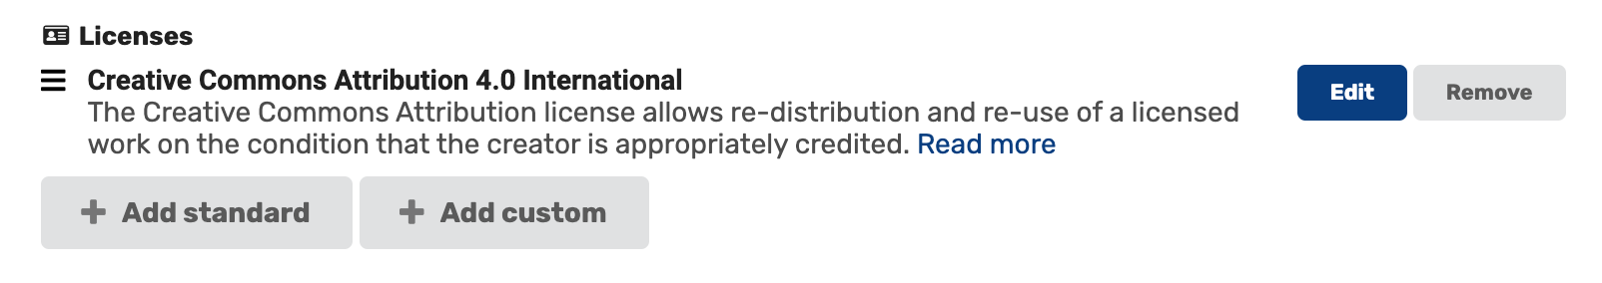
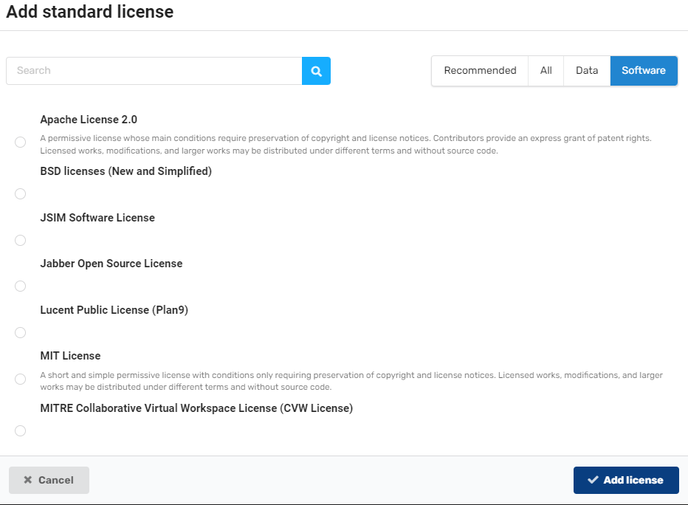
Adding a license in MSD-LIVE
Licenses are an optional metadata field in MSD-LIVE
You can choose from a standard list of common software and data licenses
You can also create your own custom license if you have specific criteria to meet for your university or organization

Slide 9
Questions? help@msdlive.org

