Slide 1
Understanding and Using DOIs

Slide 2

PIDs, URLs, and DOIs
PID: persistent identifier
DOI: digital object identifier, a type of PID
URL: address for a space on the web
DOI is a permanent way of locating content
Avoid web address failures with a DOI

Slide 3
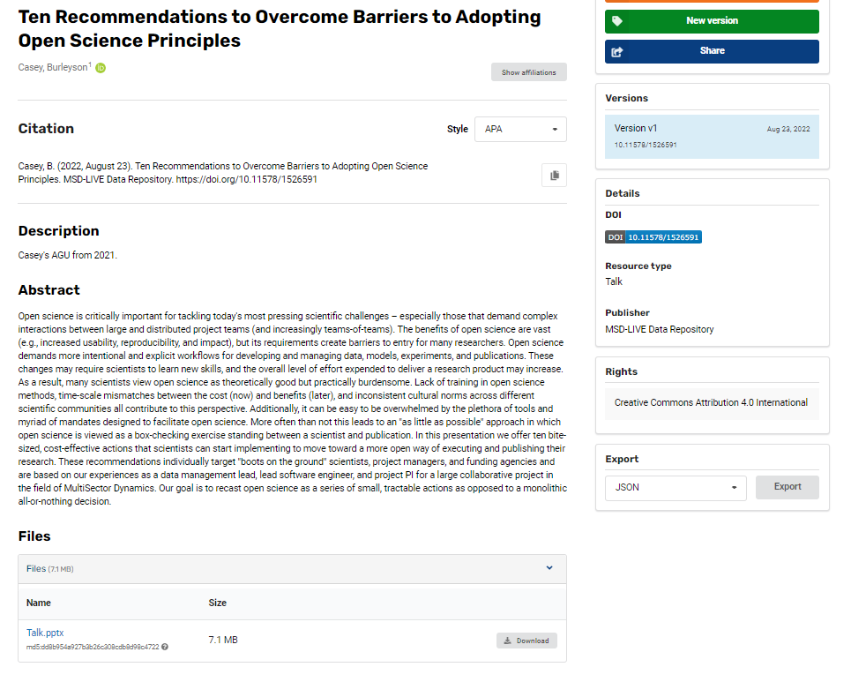

DOIs and data publishing
Citation
Casey, B. (2022, August 23). Ten Recommendations to Overcome Barriers to Adopting Open Science Principles. MSD-LIVE Data Repository. https://doi.org/10.11578/1526591
DOI
https://doi.org/10.11578/1526591
Landing page
https://data.msdlive.org/records/2gxbv-h3464
Dataset

Slide 4
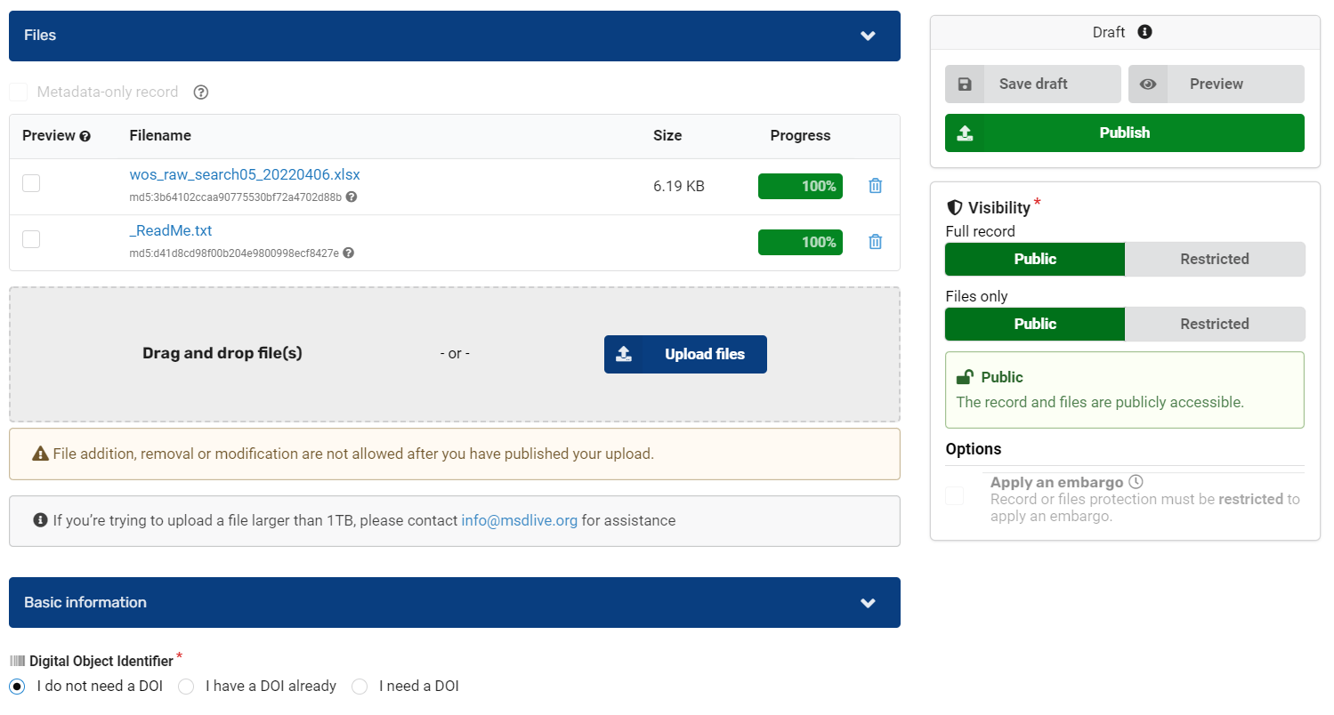
DOIs and MSD-LIVE

Slide 5
DOIs and MSD-LIVE

Slide 6
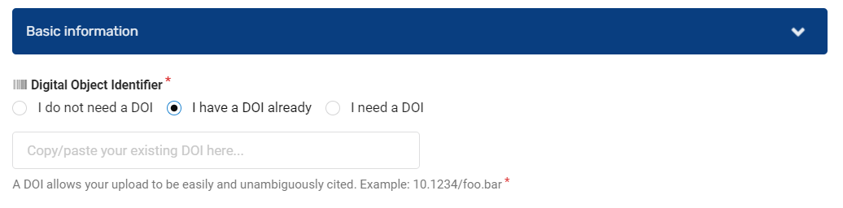
DOIs and MSD-LIVE

Slide 7
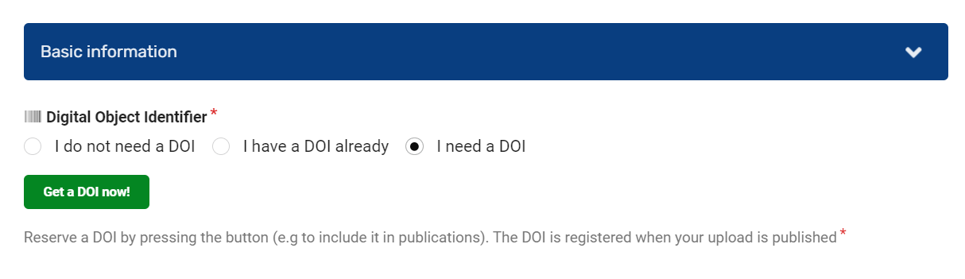
DOIs and MSD-LIVE

Slide 8
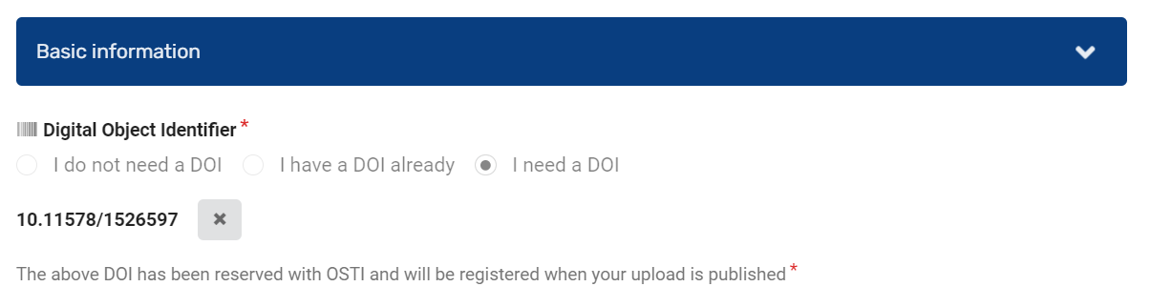
DOIs and MSD-LIVE

Slide 9
Questions? help@msdlive.org

