Slide 1
Citing Datasets in Publications

Slide 2
Why cite data?
Data is a legitimate, citable product of research
Citing datasets benefits everyone
Data producers:
  Provides proper attribution and credit
  Creates bibliographic “trail”
  Demonstrates impact of their work
Data users:
  Easier to find datasets
  Supports persistence of datasets
  Encourages the reuse of data for new research questions
Everyone:
  Increased transparency
  Increased reproducibility

Slide 3

What to include
Author
Date of Publication
Publisher and/or Distributor
Electronic Location or Identifier (DOI)
Version (when appropriate)
Date accessed (when appropriate)

Slide 4
Example citations
Style | Example
APA (6th ed.) | Smith, T.W., Marsden, P.V., & Hout, M. (2011). General social survey, 1972-2010 cumulative file (ICPSR31521-v1) [data file and codebook]. Chicago, IL: National Opinion Research Center [producer]. Ann Arbor, MI: Inter-university Consortium for Political and Social Research [distributor]. doi: 10.3886/ICPSR31521.v1
Chicago | Smith, Tom W., Peter V. Marsden, and Michael Hout. 2011. General Social Survey, 1972-2010 Cumulative File. ICPSR31521-v1. Chicago, IL: National Opinion Research Center. Distributed by Ann Arbor, MI: Inter-university Consortium for Political and Social Research. doi:10.3886/ICPSR31521.v1
Figshare | Rodriguez, Tommy (2013): 17,170 Base Pair Alignment of Thirteen Time-Extended Lineages [data: (complete) mtDNA; format: ClustalW]. figshare. https://dx.doi.org/10.6084/m9.figshare.815894 Retrieved: 16 26, Jan 04, 2016 (GMT)

Slide 5
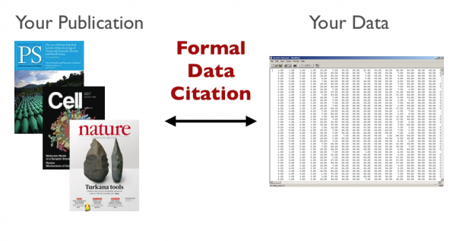
Final thoughts
Include the data citation in your list of references
Some publishers may specify format or ask for additional information
When you’re citing your own data in a paper, still cite it!

Slide 6
Questions? help@msdlive.org

