Slide 1
Best Practices for Dataset README Files

Slide 2
General content of a dataset README*
Title
Location of the data (DOI or landing page)
Contact information for dataset creator and/or principal investigator (name, institution, email)
Date the dataset was collected or committed
Information about the geographic location of the dataset
Licenses or restrictions placed on the data
Description of methods for data collection or generation
Description of methods used for data processing
Citations for the papers in which data was used
*at a MINIMUM

Slide 3
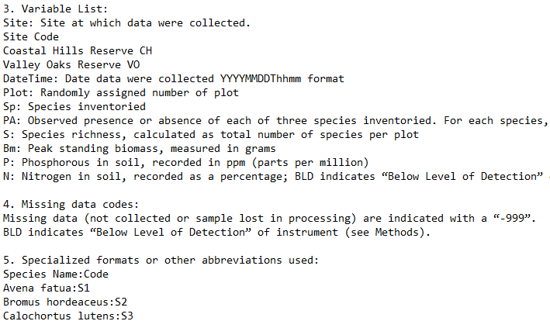
Data-specific content of a README*
A short description of what data each file or group of files contains
Date that the file was created
Variable list
Units for each variable
Definitions for codes
Symbols used to record missing data
*at a MINIMUM

Slide 4
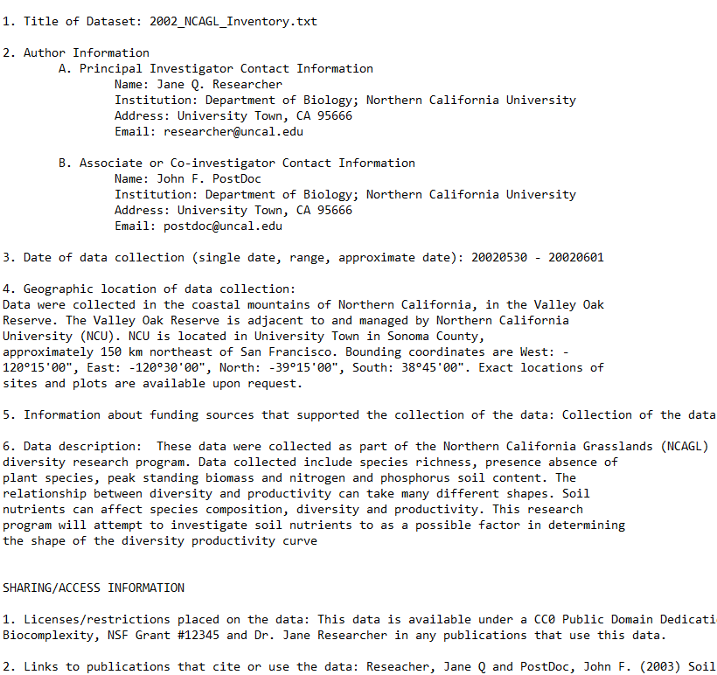
Templates
https://cornell.app.box.com/v/ReadmeTemplate

Slide 5
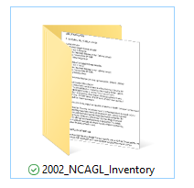

Best practices for READMEs
Document as you go
Create README files for logical clusters of data
Format multiple README files identically
Name the README for easy association with the data file(s) it describes
Save the README in the root of the directory it describes

Slide 6
Best practices for READMEs (continued)
Create the document as a plain text file
Don’t use jargon
Define terms and acronyms
Follow the scientific conventions for your discipline for taxonomic, geospatial and geologic names and keywords
Use standardized date formats (YYYYMMDD!)

Slide 7
Questions? help@msdlive.org

