Slide 1
Using Meta-Repositories To Facilitate Open Science in MSD Research
Chris R. Vernon, Casey D. Burleyson, Jennie Rice, Mengqi Zhao
Pacific Northwest National Laboratory, Richland, WA, 99354

Slide 2
outline
MSD CoP introduction (Chris Vernon) 5 mins
Overview of meta-repositories (Chris Vernon and Casey Burleyson) 15 mins
How to build your own meta-repository from scratch (Mengqi Zhao) 20 mins
How to operationalize it in your research group or team (Jennie Rice) 5 mins
Q&A with panel 15 mins

Slide 3


Welcome!
The MSD Community of Practice (MSD CoP) represents an effort to accelerate development of needed foundational capabilities through open science and growing a diverse transdisciplinary workforce.
https://multisectordynamics.org/

Slide 4
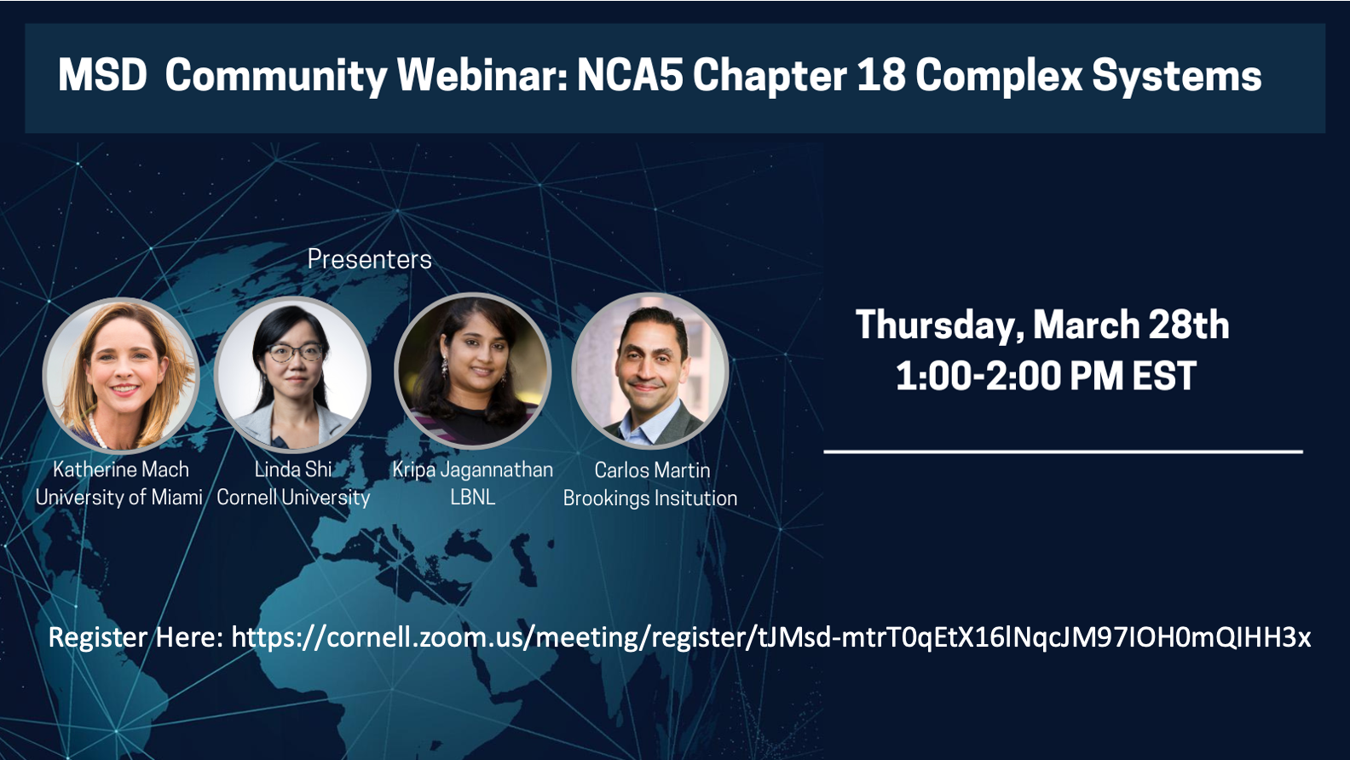

Slide 5



New Earth’s Future Special Collection
Organizers
  Patrick Reed (Cornell)
  Nicole Jackson (Sandia)
  Katharine Mach (U Miami)
  Nicholas Simpson (U Cape Town)
  Nathalie Voisin (PNNL)
  Jennifer Morris (MIT)
  Ryan McManamay (Baylor)
  Marjolijn Haasnoot (Deltares)
Submission window: May 2023-December 2024
Direct target for collaborative output from the Davis workshop

Slide 6
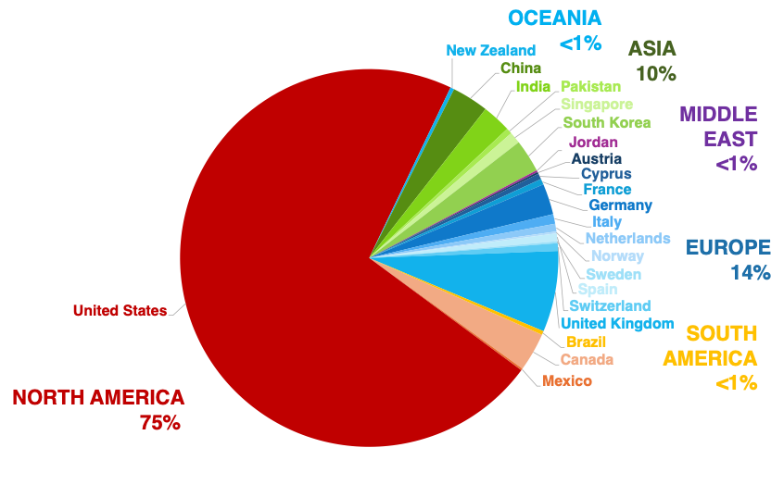
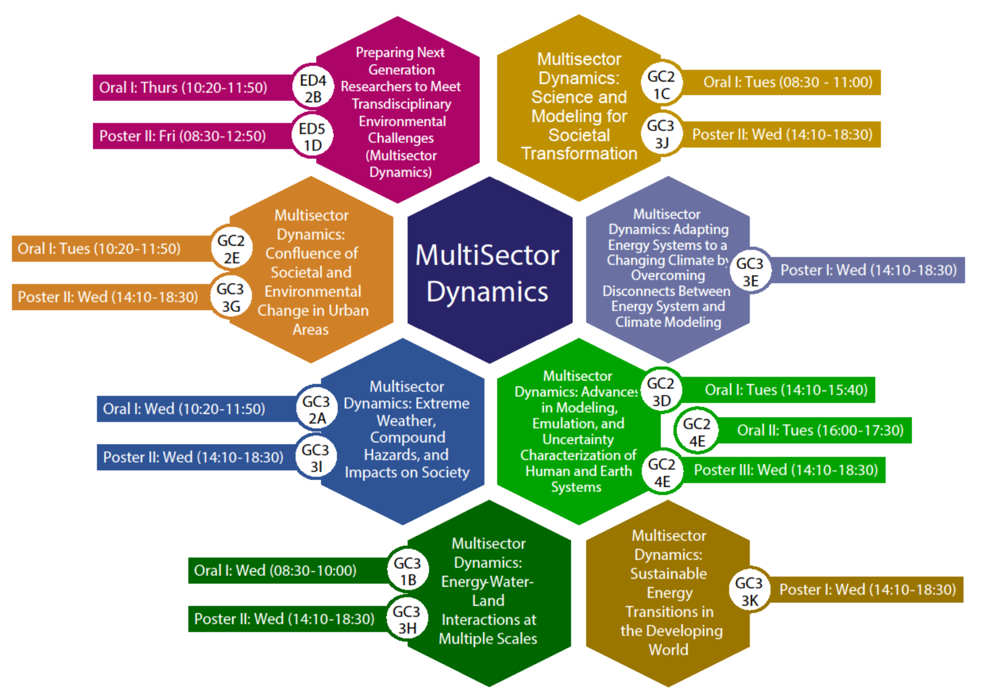
2023 AGU Fall Meeting
One of the largest coordinated topical areas in Global Environmental Change!
22 countries
37% student presenters
28% international authors
7 oral sessions
8 poster sessions
133 abstracts from 606 authors

Slide 7
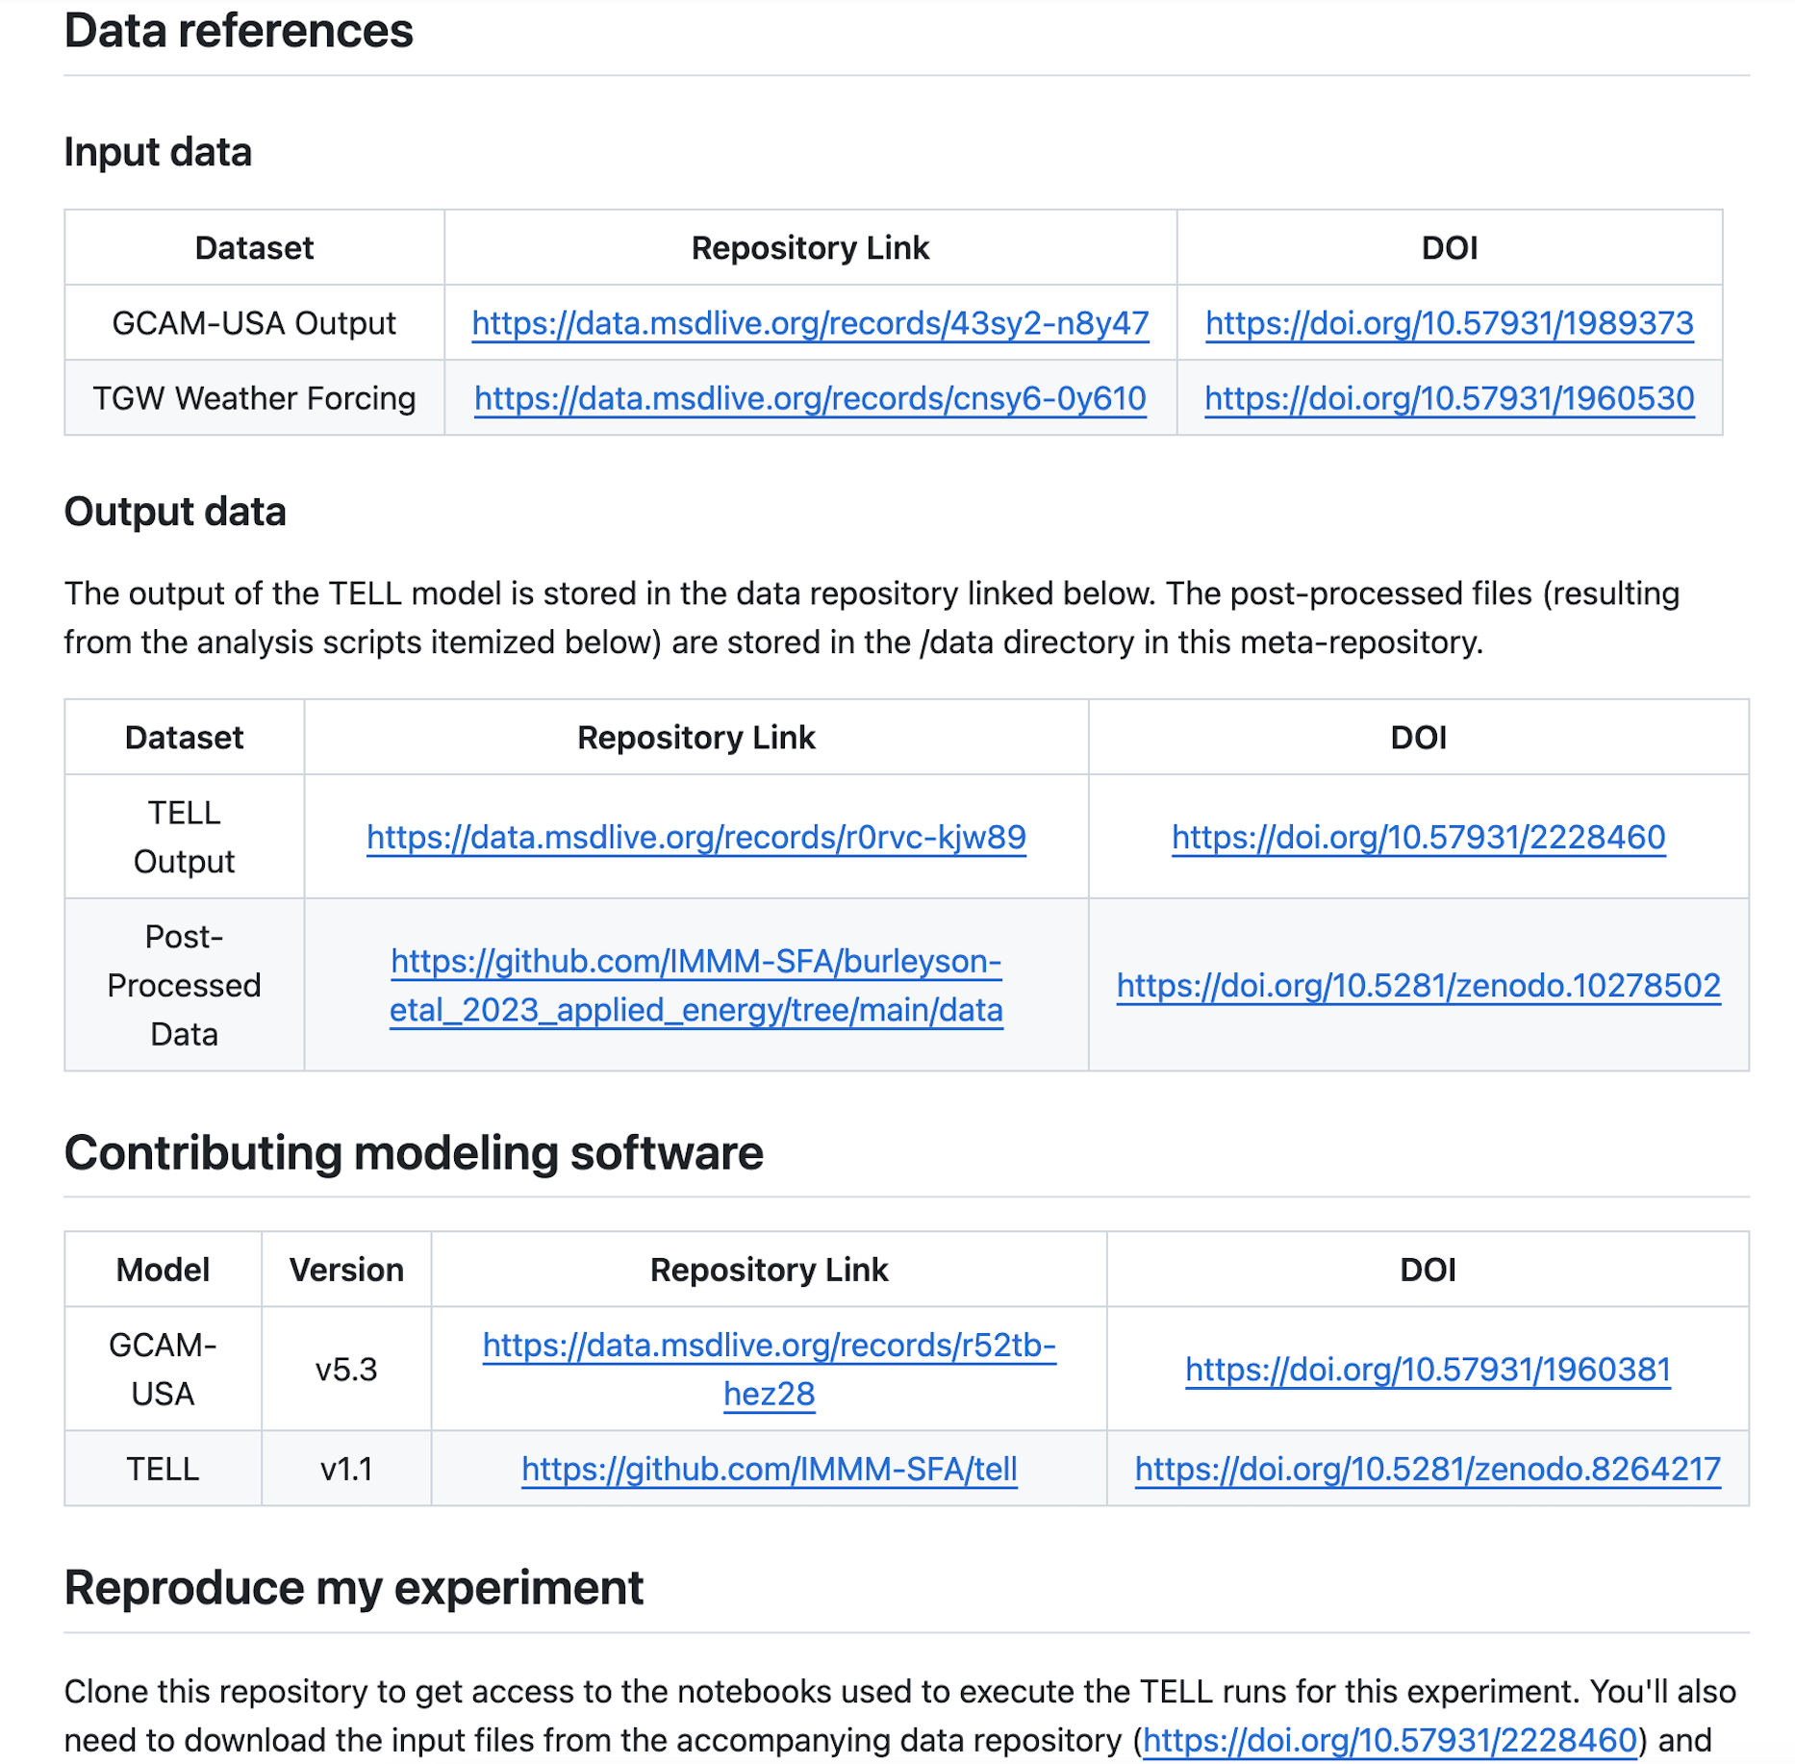

What is a meta-repository?
Referencing part of a meta-repository extracted from:
https://github.com/IMMM-SFA/burleyson-etal_2024_applied_energy
The meta-repository is an IM3-developed approach that provides a single point of access to reference, reproduce, and show the process behind any data or figures used in a publication.
It is a digital document (e.g., GitHub, etc.) that can be versioned and archived
GOAL: To disseminate your research in a way that someone who has no understanding of your subject matter could walk step-by-step through a document describing your process and reproduce your results
IM3 meta-repository template: https://github.com/IMMM-SFA/metarepo

Slide 8
Benefits of meta-repositories
A few journal review feedback examples!
Demonstrates transparency and reproducibility
Provides the "power to make the stuff"
Saves money, saves time, saves "face"
Enables quick on-boarding of new staff or collaborators
Generates a deeper understanding of the science we are communicating
Produces a sense of value knowing that you have supported those who will continue where you have left off
"The paper is very well written and clear. Its accompanying supporting material and commented code are exemplary."
"I have reviewed the paper and found that the paper's results were reproducible based on the GitHub repository. Further, I commend the authors for an exceptional job of producing well-organized code with clear instructions for reproducibility. I agree that this paper should be deemed fully reproducible and given the highest rating for reproducibility."
"Congratulations to the provided meta-repository on GitHub which I enjoyed exploring."

Slide 9
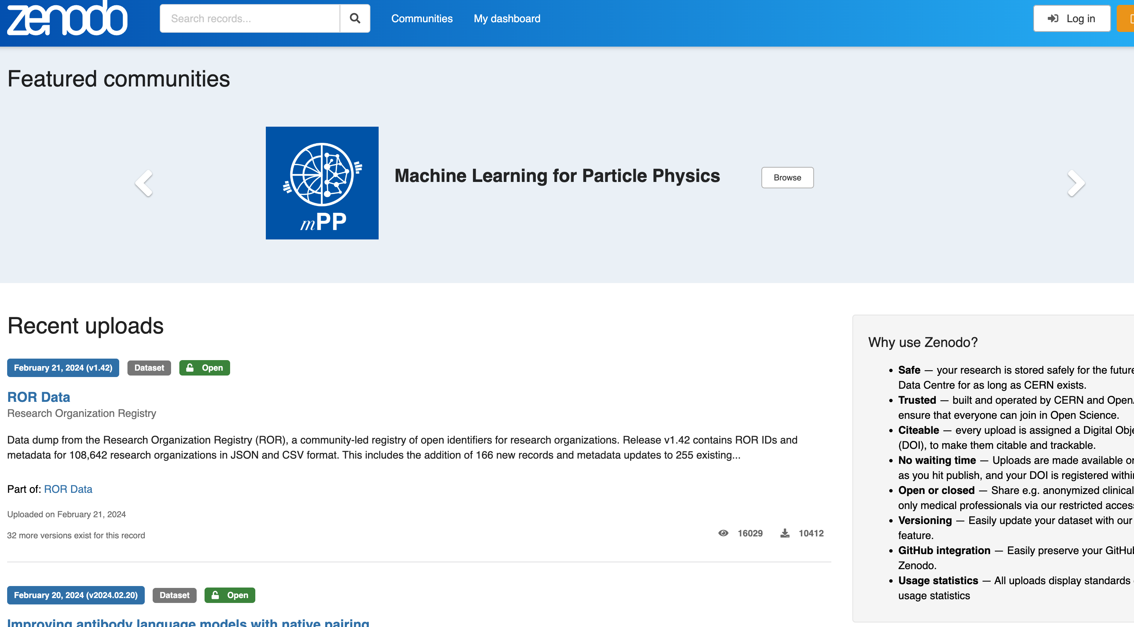
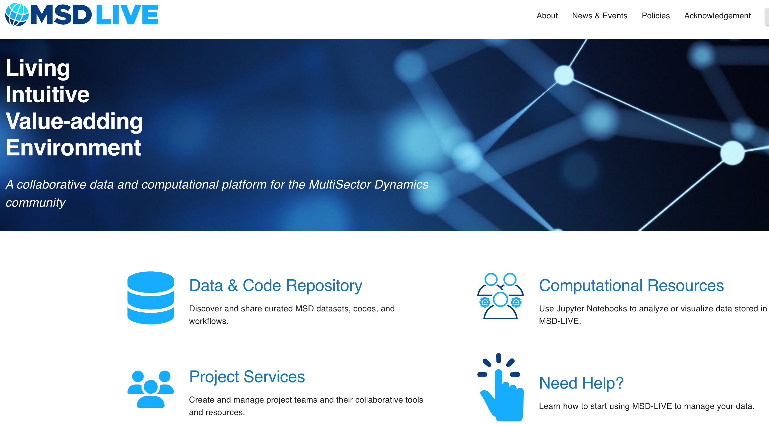
Using data repositories to Archive Data
DOE MSD projects can use MSD-LIVE: https://msdlive.org/
MSD-LIVE is the canonical source for MSD datasets
Full data repository with permanent storage, DOIs, and MSD-specific metadata fields
No file or dataset size limits
Non-MSD projects can use free public repositories like Zenodo: https://zenodo.org/
Data repository with limited permanent storage, DOIs, and generic metadata fields
Maximum dataset size of 50 Gb

Slide 10
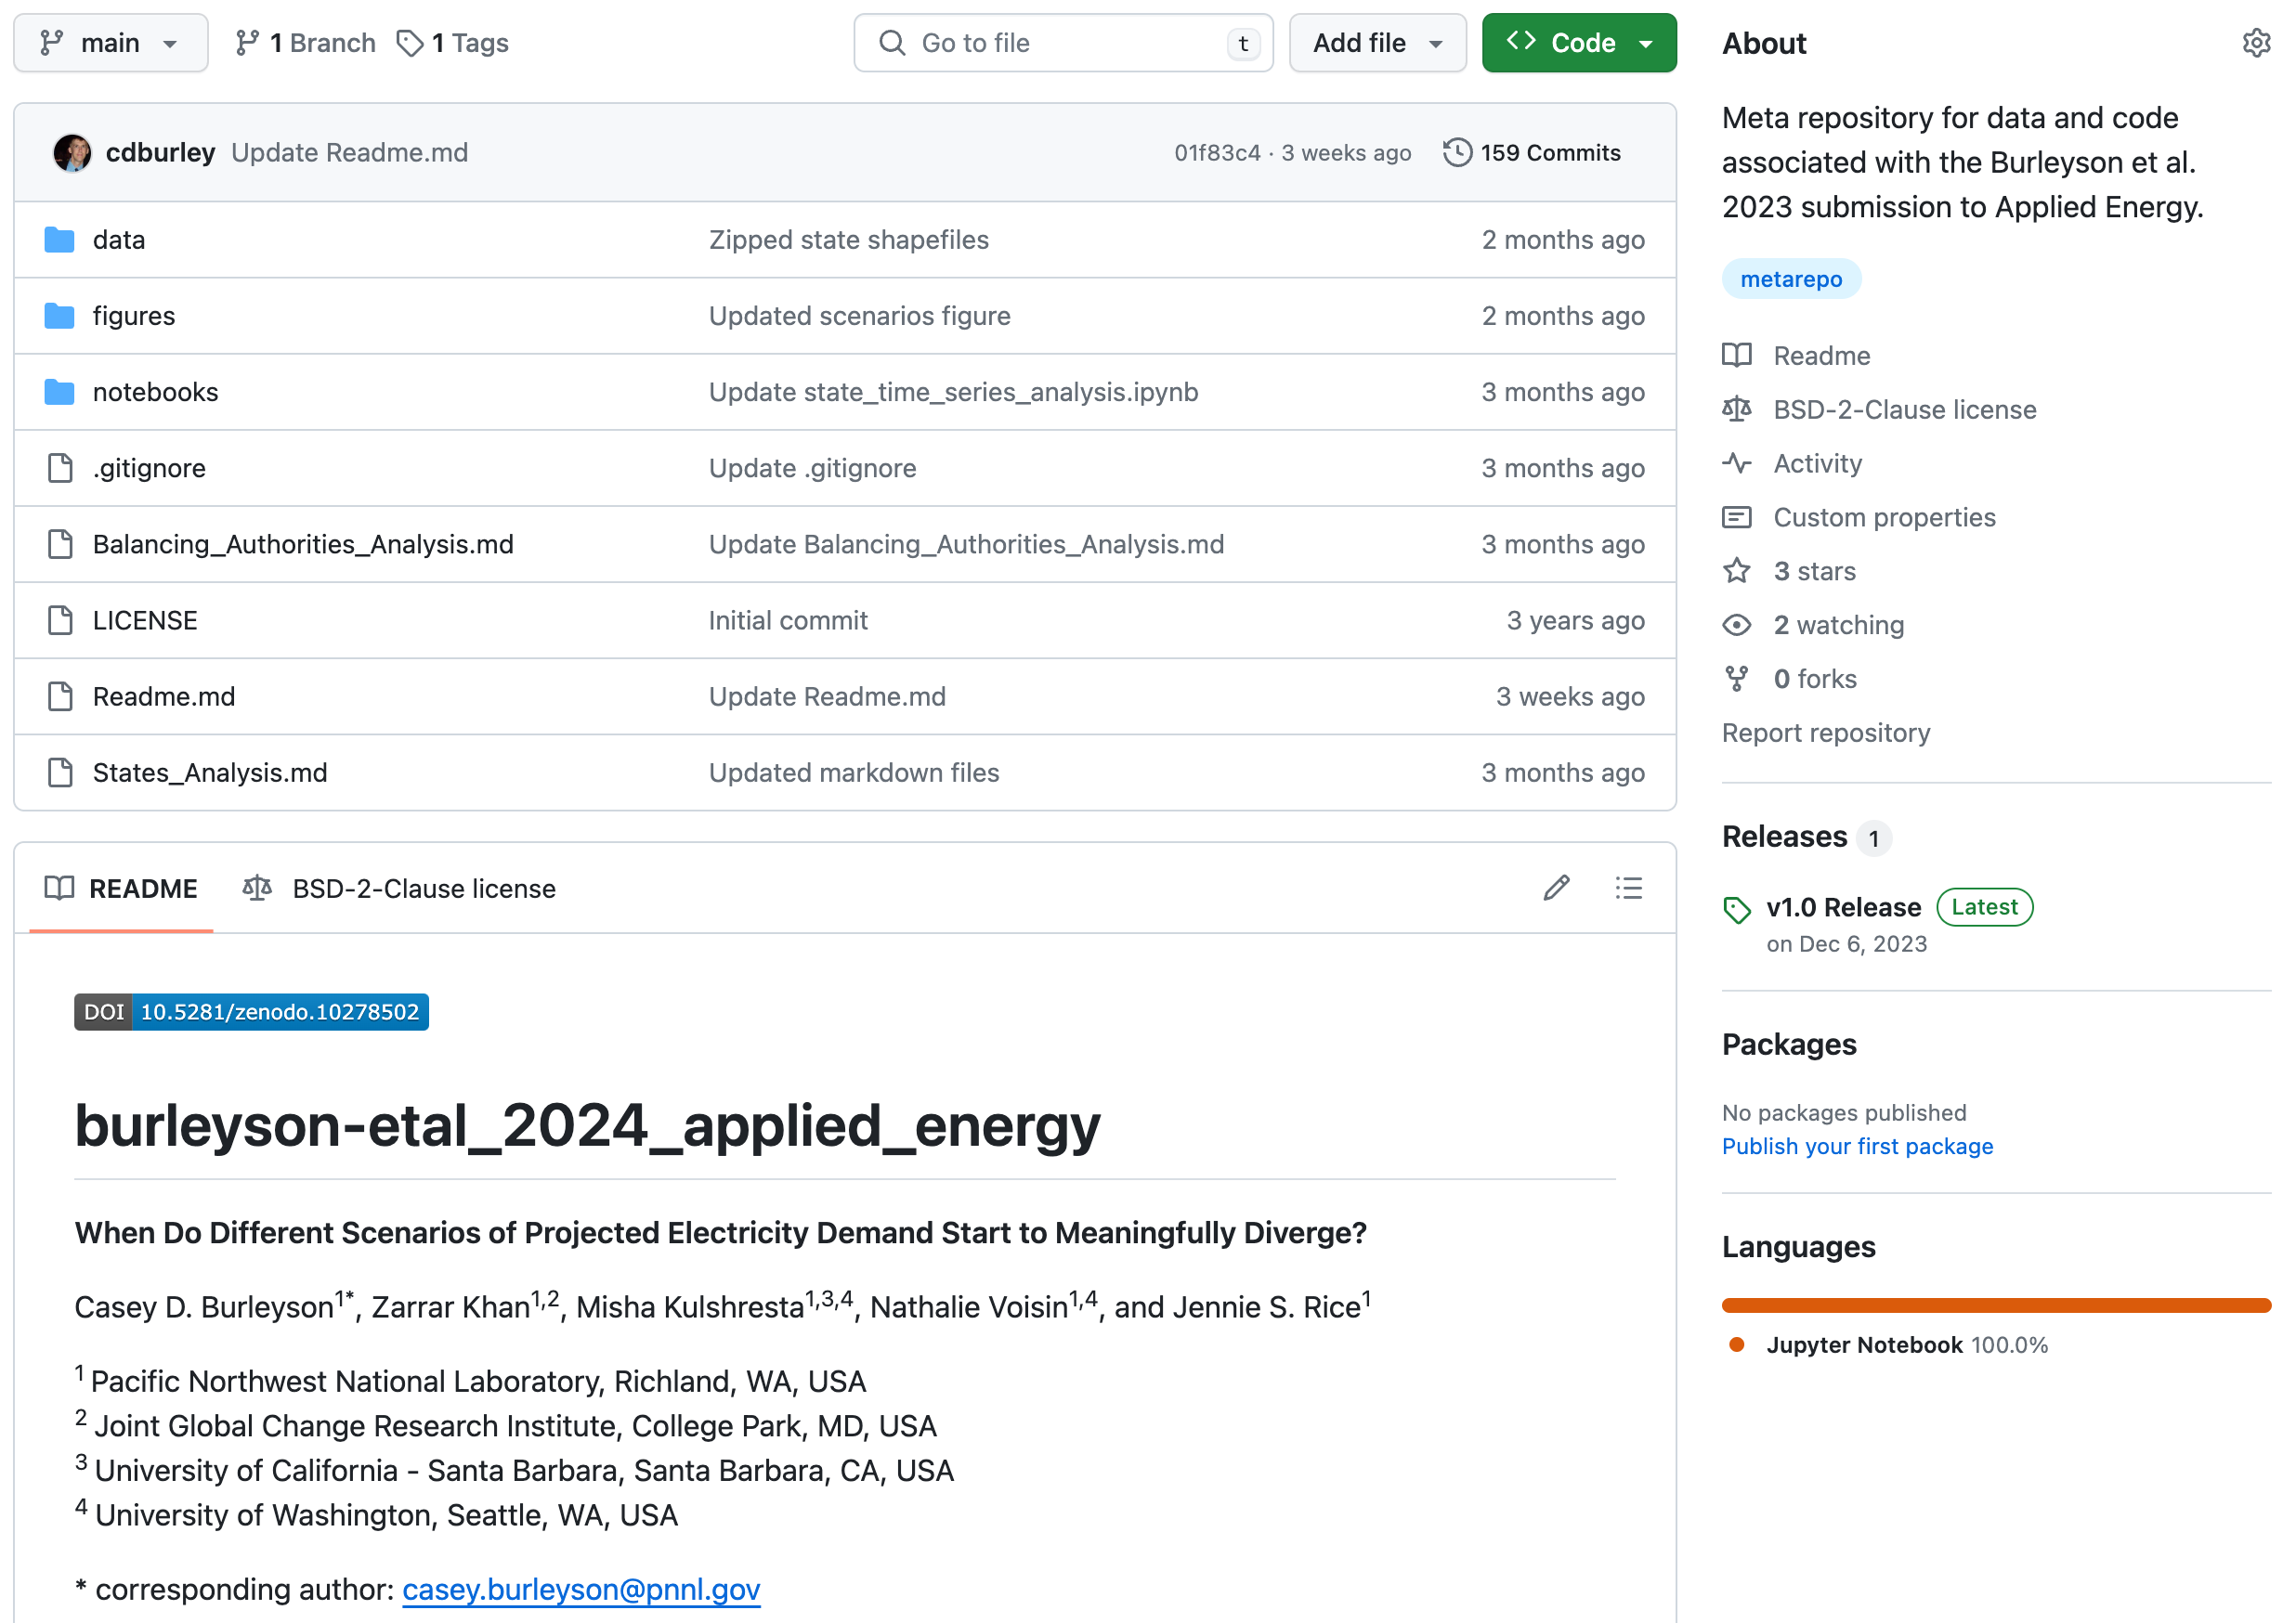
Example Paper-In-Progress meta-repository
https://github.com/IMMM-SFA/burleyson-etal_2024_applied_energy
Folder structure to organize elements
Meta-repository gets its own DOI for permanence
Standardized naming convention indicates that this is a meta-repository

Slide 11
Key Points Of Building a Meta-repository
Use this template: https://github.com/IMMM-SFA/metarepo
What are the key components of a meta-repository?
Prepare your data and code.
Can others reproduce my experiment by following my instructions?
Create a citation and DOI for the entire meta-repository.
Cite the meta-repository in your paper.
Include the meta-repository when you submit your manuscript.

Slide 12
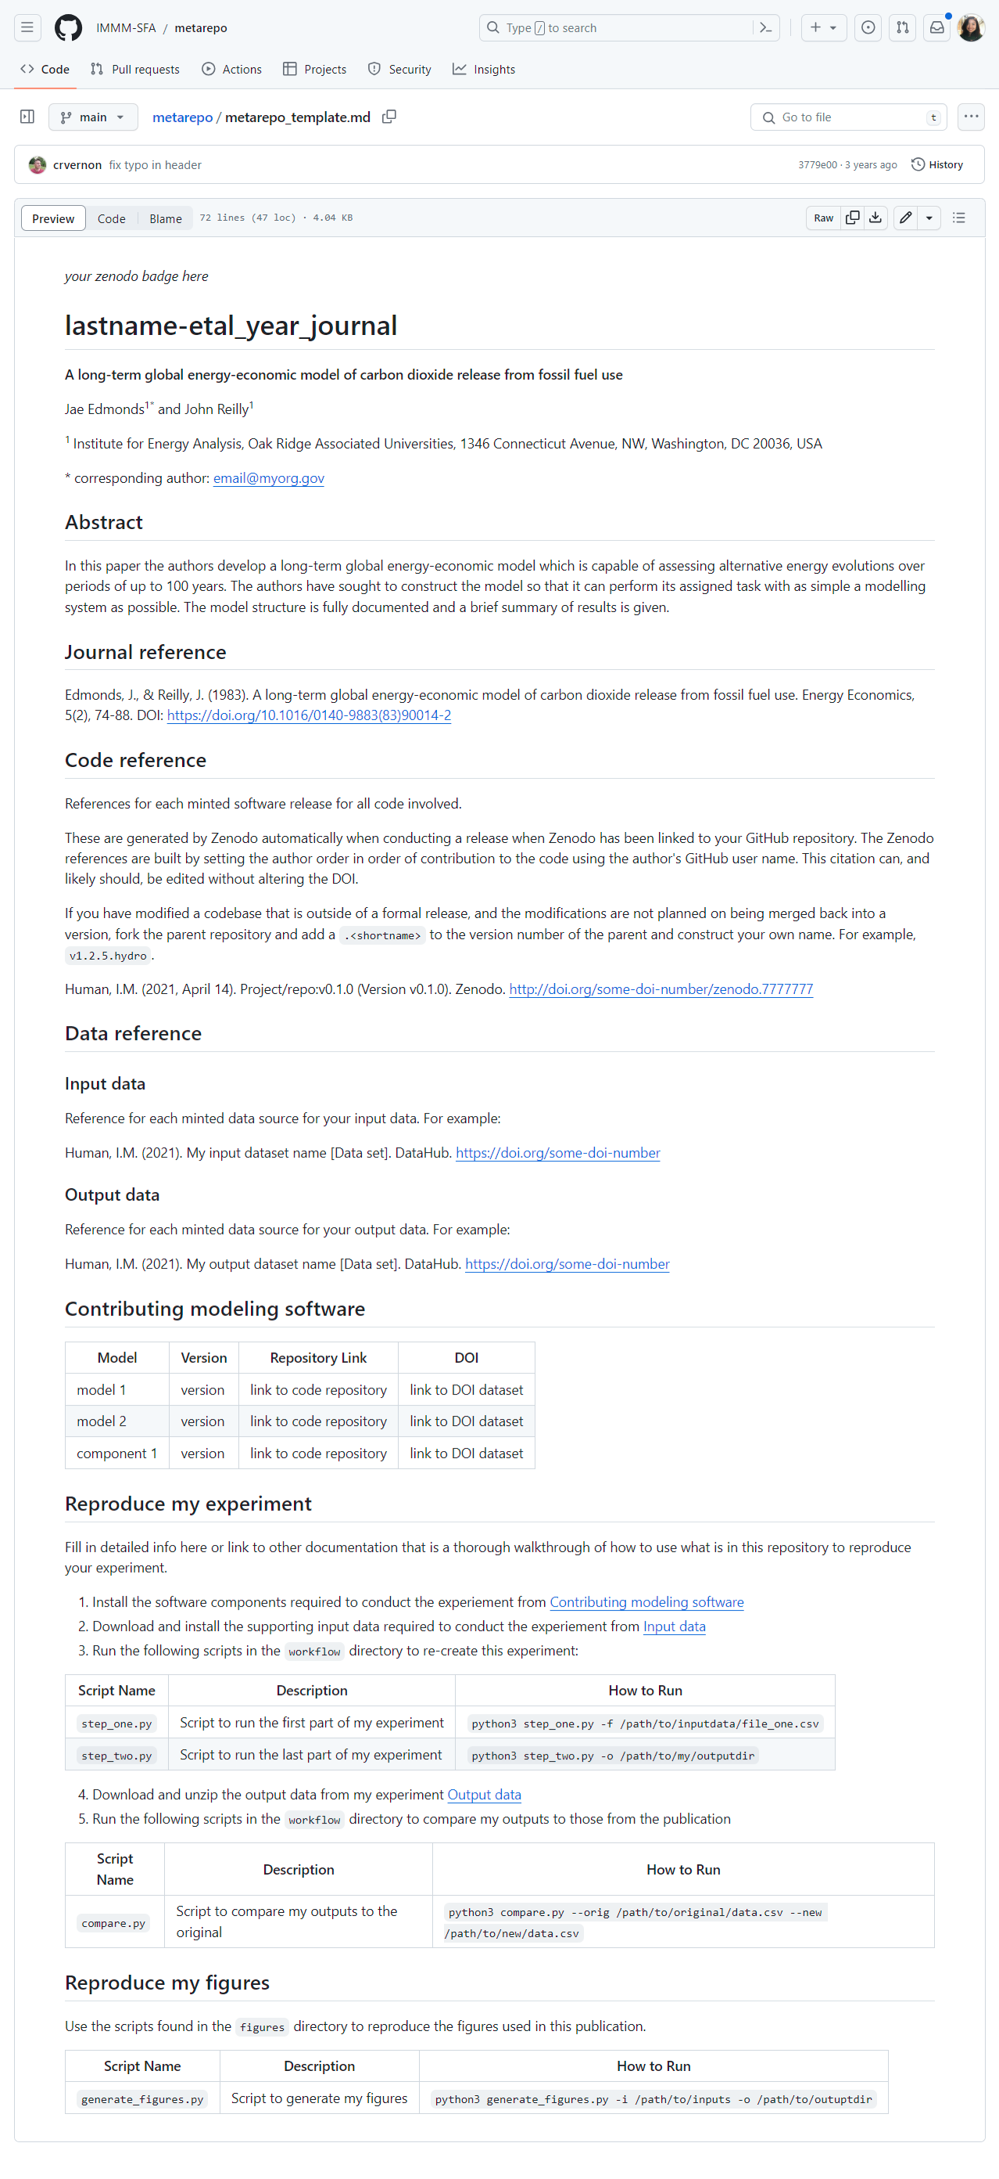
IM3 Meta-Repository Template

Slide 13
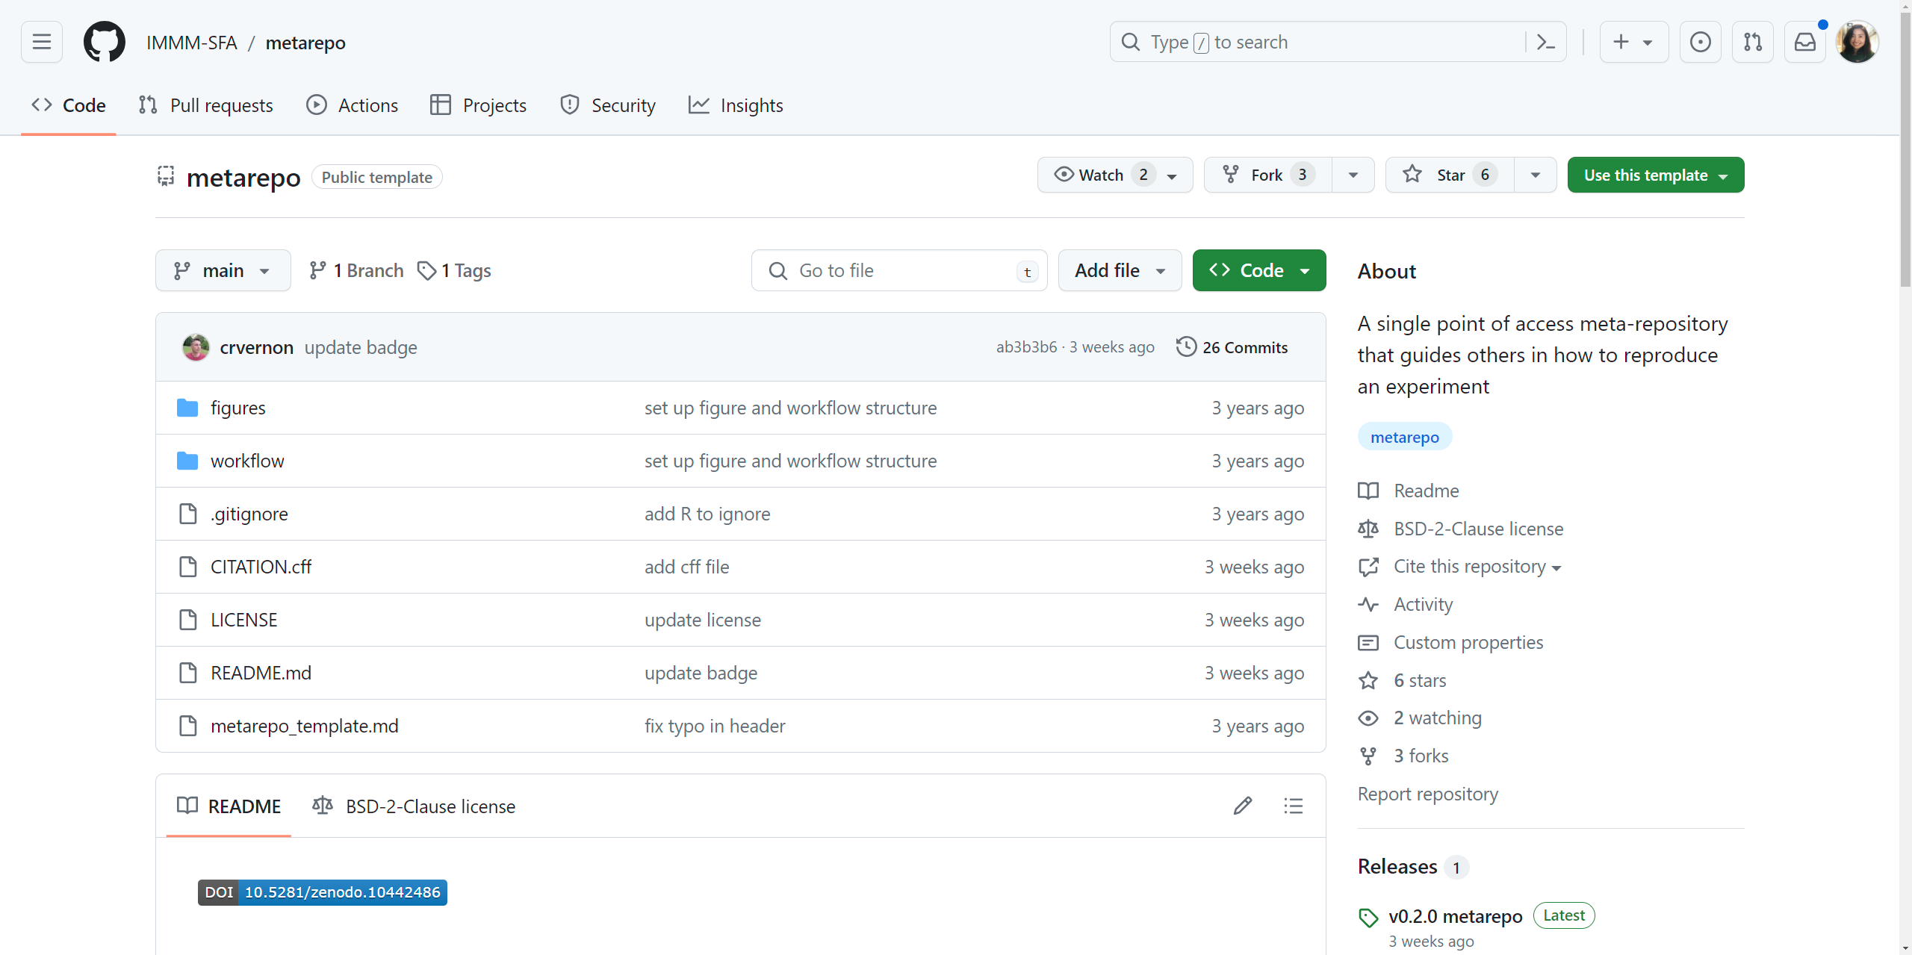
IM3 Meta-Repository Template

Slide 14


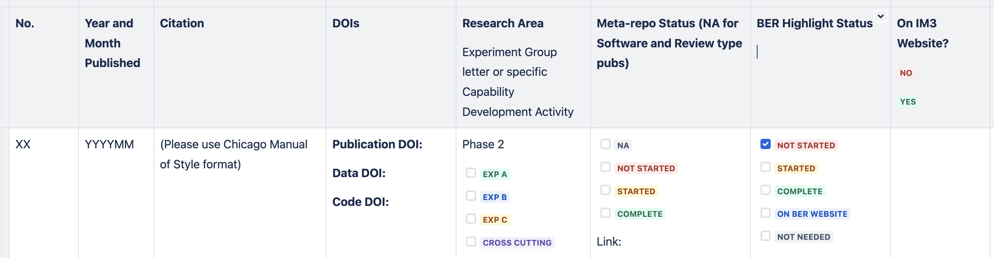
How to “operationalize” meta-repositories in your project
Commit at the PI level
Require for every manuscript (excluding software journals like JOSS) after a start-up period
Monitor meta-repo status
Train regularly
Adopt a ”train the trainer” approach: get early adopters to train others
Publicize the positive feedback from journals and reviewers!

