Slide 1
Best Practices for File Naming Conventions and Folder Hierarchy

Slide 2
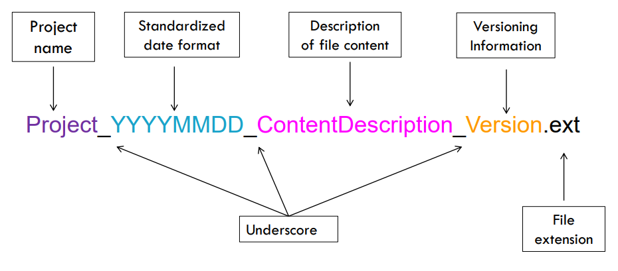
File naming schemas

Slide 3
Questions to consider
What group of files will this naming convention cover?
What information is important about these files and makes each file distinct?
Do you need to abbreviate any of the metadata or encode it?
What is the order for the metadata in the file name?
What characters will you use to separate each piece of metadata in the file name?
Will you need to track different versions of each file?
Example: My file naming convention is “SA-MPL-EID_YYYYMMDD_###_status.tif”
Examples are “P1-MUS023_20200229_051_raw.tif” and “P2-DRS-285_20191031_062_composite.tif”.

Slide 4
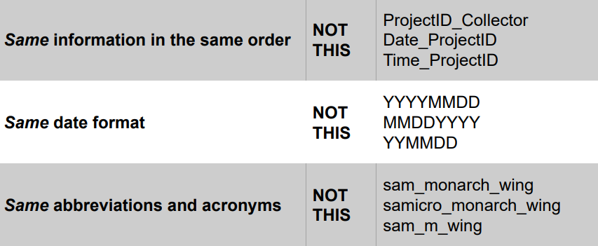
Other best practices: Consistency
Be consistent
Notes:
So, that takes care of our questions. Now let’s look at a few other best practices to keep in mind when coming up with naming conventions. The first is consistency. Documentation really helps here, which we’ll discuss later. But consistency is especially important to remember when multiple people are expected to apply a particular naming schema, such as in collaborations. We want to codify that we’re treating our information the same—otherwise the system loses a lot of it’s efficacy. So make sure the information is in the same order, that you’re all using the same date format, and that abbreviations and acronyms are standardized.

Slide 5
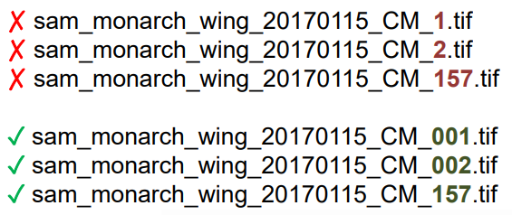
Other best practices: Leading zeros
When using sequential numbering, use leading zeros.
For a sequence of 1-10: 01-10
For a sequence of 1-100: 001-010-100
This allows files to sort well & have consistent name lengths.
Notes:
You also want to make sure you’re deploying leading zeros appropriately any time you’re using sequential numbering. Instead of starting of with just 1, 2, 3, you’ll want to add on the appropriate number of zeros to make sure the file sort well and have consistent name lengths. This image probably does a better job of showing how that happens than me trying to describe it to you, so you can just take a look at how that happens in practice. Our bottom three files will sort much better than the top three and in proper chronological order

Slide 6

Other best practices: Format
Limit file names to 32 characters or less.
  The longer the filename, the longer the file path to type.
  Shorter names are easier to quickly scan to know what file is.
thisIsTheFileNameThatDoesntEndItJustGoesOnAndOnMy Friend.ext
32CharactersLooksExactlyLikeThis.ext
shorter_is_better.ex
Notes:
Our last best practice is to consider the format of the file name. We already talked about using an underscore to separate the metadata in the file name, but I did want to address the period for a moment, because using a period used to be considered fine practice. But there are some potential pitfalls, especially with file extensions, so it’s better to not use them at all. Finally, try to limit your names to 32 characters or less. This makes it easier to type if you’re programming, and also makes it easier to scan for human.

Slide 7
Organize folders by meaningful categories
Primary / Secondary / Tertiary …
[Project] / [Sub-project] / [Date] / [Experiment] / [Instrument]
[Project] / [Project Site] / [Data]
[Project] / [Type of file] / [Data collector name] / [Date]
/ butterfly / 1_projectDocs / mtgNotes /
/ butterfly / 1_projectDocs / reports /
/ butterfly / 2_data / images / monarch /
/ butterfly / 2_data / observations / monarch /
/ butterfly / 3_analysis / monarch /
Notes:
Your first step is to organize folders by meaningful categories. Even more so than the naming conventions, this is where I highly encourage you to do what works for you or your project. We’ll talk about some best practices for how many and how deep, but these are just a few example templates here, where we have different ways of breaking files up, such as by project site, file type, or project. Again, there is no single right way to do this—it’s what makes sense in your unique context, and you’ll be the person who knows that best. This slide shows some proposed categories and structures, and what that might look like in an actual structure.

Slide 8
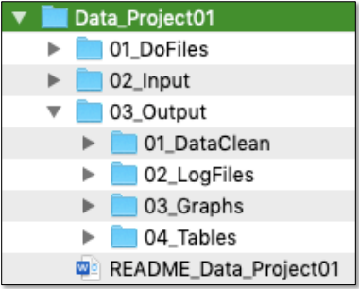
Choose a directory naming convention
Same approach as file naming
Determine your unique elements
Consider ordering and abbreviations
Consider creating a blank template
Notes:
Just like we created a file naming convention for individual files, you’ll want to do the same for your folder organization. Follow the same guidelines and best practices we discussed in the file naming section, things like determining your unique elements and considering order and abbreviations. You have a bit more flexibility in folder names than file names, if only because you shouldn’t have nearly as many to think about naming.
It can also be useful, if you find a system that works really well for you or for a project, to create a blank template that you or others can use in the future. This is basically just the set of empty files that are named and organized in a way that works for you.
Now, let’s look at some other best practices to think about while creating this organizational structure

Slide 9
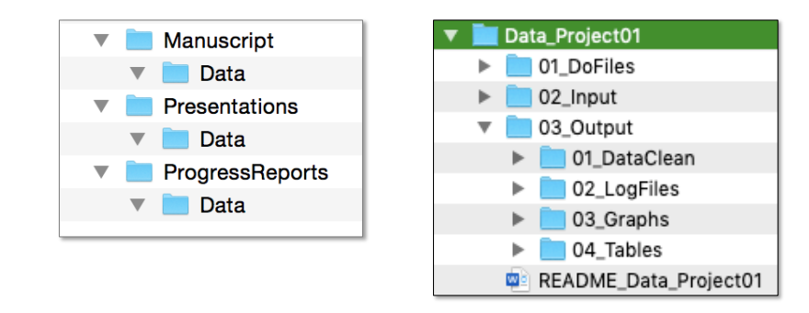
Organization: Folders and sub-folders
Best Practices
Avoid overlapping categories
Tip: Use numbers as a folder name prefix to order folders how you’d like to view them (e.g., 01_DataClean, 02_LogFiles).
Notes:
First, you want to avoid overlapping categories. A big place you see this is multiple folders called “Data”. This can get confusing rather quickly—there’s always the extra step of specifying which data folder you mean, and things have a bad habit of getting saved in the wrong place.
I also like this little tip here about using numbers in folder names to help order them. Sometimes it’s unnecessary, but sometimes it’s also really nice to control the order the files show up in, and not have to default to alphabetical order.

Slide 10
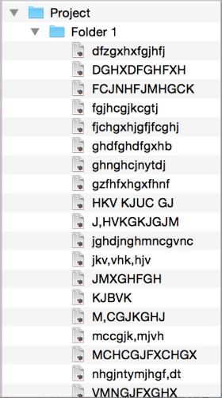
Organization: Folders and sub-folders
Best Practices
Avoid overlapping categories
Don’t let your folders get too large
Notes:
Next, in general we want to avoid folders that are too large. Of course, this won’t hold for certain exceptions, such as including all of one data type in a folder. But in most cases, you want folders to be manageable for a human to look through. This means not creating folders that are overly broad or contain too many files that are not closely related.

Slide 11
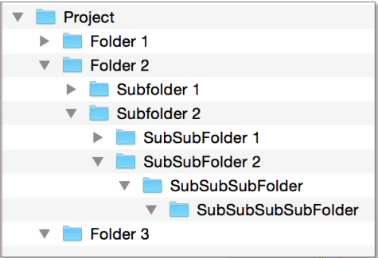
Organization: Folders and sub-folders
Best Practices
Avoid overlapping categories
Don’t let your folders get too large
Don’t let your structure get too deep
Tip: Consider how many clicks it takes to get there or how long a file path may be
Notes:
At the same time, we don’t want our folder structures to get too deep. Think about how many clicks it takes to get there or how long a file path may be. These best practices are helpful for you as a human looking at the folders, but they can also make it much easier to navigate and work through the files programmatically as well. It’s a balance between not going too large or too deep, and what makes sense for one project or researcher may not for someone else.
So now that you have probably way to many considerations in your head, let’s looks at two examples of folder structure. I know seeing real examples, and not just the theory behind them, helps me, so these are to give you an idea of how this might look in practice.

Slide 12
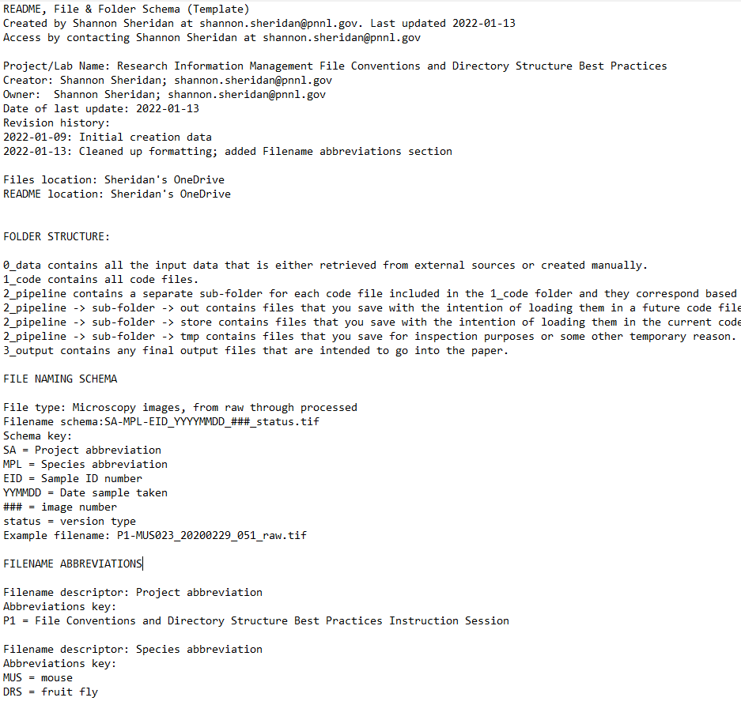
Create a ReadMe
Create a README file to document your file organization system.
Notes:
A ReadMe for your organization system. This differs slightly from a normal ReadMe documenting data or code in that you are writing down the structure, schemas, and conventions you’ve just come up with. You can include all the content we’ve talked about, like what schemas apply to what file types or categories, what the folder structure is, abbreviation keys that you’ve created, and even who is responsible for the oversight of the schema. It also keeps that information organized and accessible in one place. This ReadMe should be kept at the base of your directory so that it’s easy to find for you and anyone else who will be looking at your files.
Don’t be afraid to let things evolve, either. If you’re working through a project and find you have new needs, or something isn’t working like you hoped it would, your structure and ReadMe don’t need to be considered an ironclad agreement. Experiment or try new tactics until you get what works for you. But make sure you’re documenting those changes, so that future you or other collaborators can understand them.

Slide 13
Questions? help@msdlive.org

