Slide 1
Choosing a Dataset License

Slide 2
Picking a license
Use a common license
Check with your sponsor or institution
Consider Public Domain
Consider discipline-specific license
Which license allows a wide audience and range of uses?
*at a MINIMUM

Slide 3
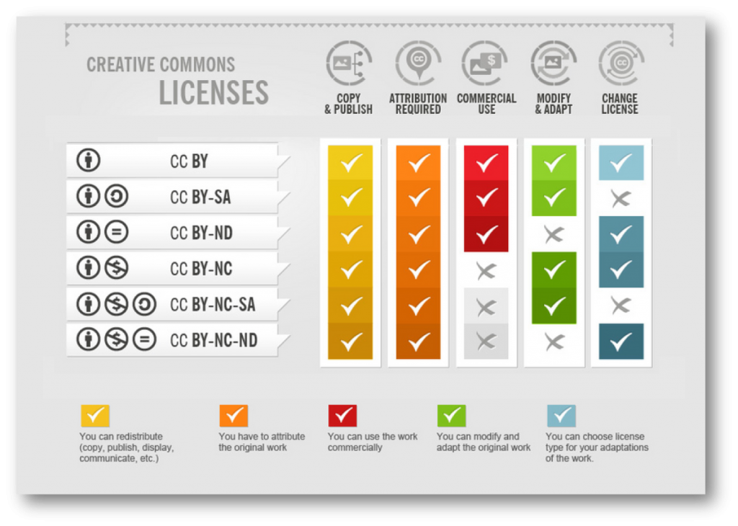

Slide 4

Public Domain
A few options
  CC0
  Public Domain Dedication and License
Why use the public domain?
  Prevents attribution stacking
  Can still receive attribution

Slide 5
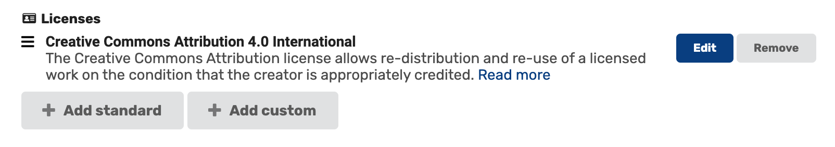
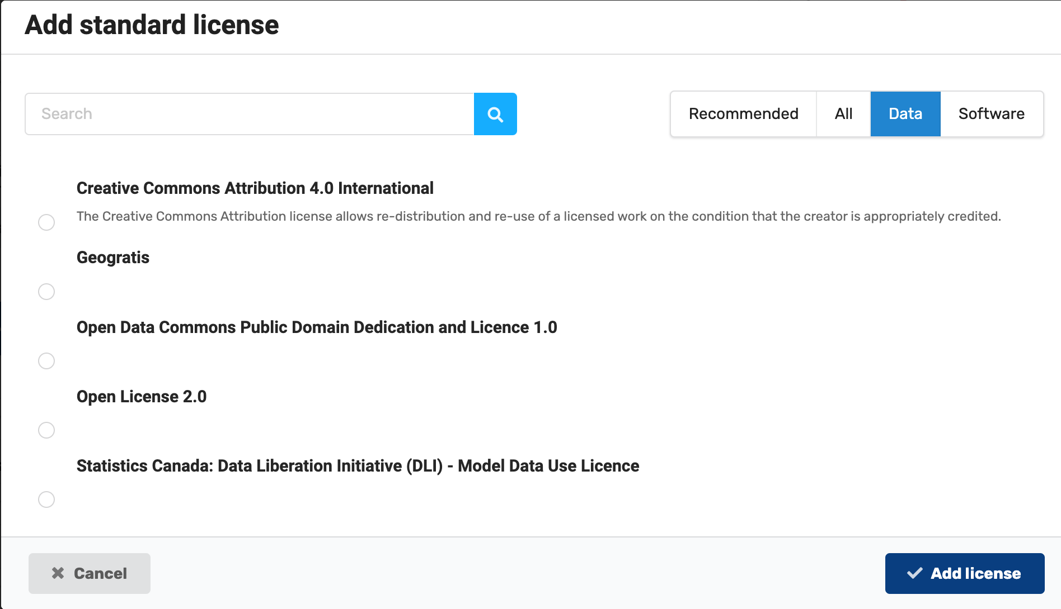
Adding a license in MSD-LIVE
Licenses are an optional metadata field in MSD-LIVE
You can choose from a standard list of common data and software licenses
You can also create your own custom license if you have specific criteria to meet for your university or organization

Slide 6
Questions? help@msdlive.org

