Slide 1
MSD-LIVE v1.0 Release Webinar
23-August 2022
Casey Burleyson, Carina Lansing, Zoë Guillen, Matthew Macduff, Devin McAllester, Elvis Offer, Anna Sabin, and Jon Weers

Slide 2
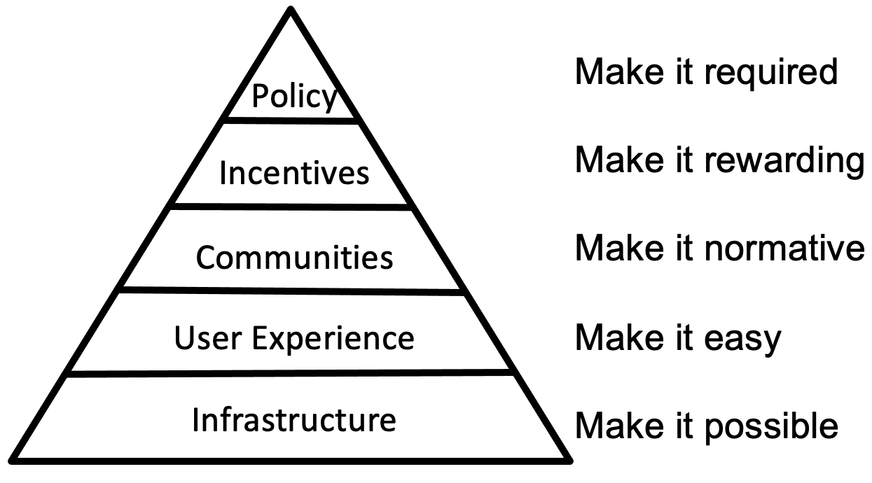
Facilitating Open Science With the MSD-LIVE Platform
Journals largely skipped to this end of the pyramid…
MSD-LIVE is about tackling these foundational elements of the pyramid…
Conceptual diagram from Brian Nosek of the University of Virginia and the Center for Open Science

Slide 3
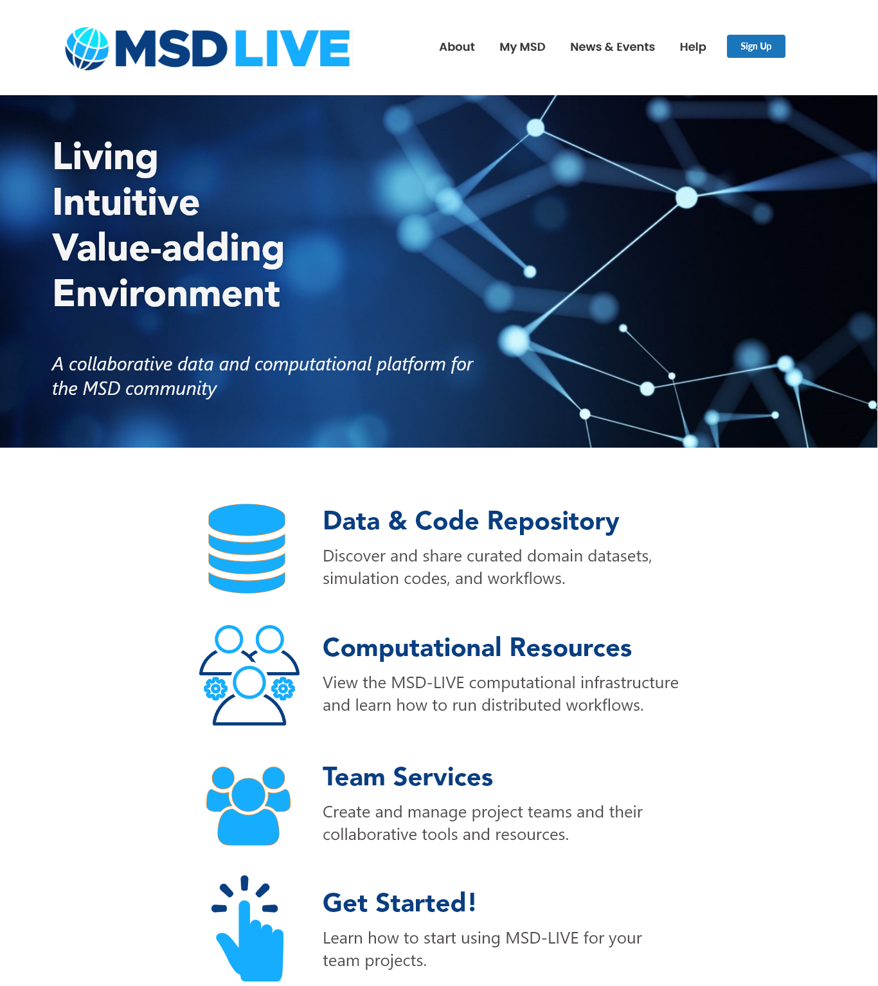
Our Vision for MSD-LIVE
MSD-LIVE is a cloud-based data and code management system and advanced computing platform
Will enable researchers to document and archive their data, run their models and analysis tools, and share data, software, and multi-model workflows
A cornerstone capability of the MSD Community of Practice
Phase One: Mar 2021 – Sep 2022

Slide 4
Top-10 Most Pressing Use Cases
Use Case | Name | Description
1.1 | Find Data | Quickly and easily find datasets produced by other users and projects
1.2 | Archive Data | Permanently archive small (<250 MB), medium (250 MB - 50 GB), and large (50 GB to 20 TB) final-form datasets and generate data Digital Object Identifiers (DOIs) in order to meet journal requirements for data sharing
1.3 | Version Control | Use an intuitive web-based user interface to document and share versioned datasets and associate data with the code used to produce it
1.4 | Training | Train new team members on MSD projects to effectively manage data and code and capture the institutional knowledge of members that leave a project
1.5 | Control Access | Create and manage teams that cross institutions in order to quickly and easily grant access to data and code without having to obtain multiple sets of institutional credentials
2.1 | Share Data | Share working datasets across multiple institutions collaborating on a project in real-time
2.2 | Analyze Data | Create, run, and share Jupyter notebooks to analyze or visualize datasets in MSD-LIVE
2.3 | Multi-Model Workflows | Create, execute, document, and publish multi-model workflows where component models run on computational resources at different institutions
2.4 | ML/AI | Virtually assemble data lakes and execute ML/AI algorithms on large pools of data that may be physically located in different places
2.5 | Move Code to the Data | Easily deploy models to run on new computational resources and make it easy for users to bring their code to the data when transferring data is infeasible
4

Slide 5
Focusing on the Data Repository
Invenio RDM provides dataset and software archival and publishing
Provides immediate value to ALL projects and will contribute to a wide and deep user base.
The data repository can be developed independently of the advanced computing components, but the reverse is not true.
The best way to provide value and build trust with our users is to focus on building complete, easy-to-use components and investing time to train the community to use them.
PNNL provides the enabling infrastructure

Slide 6
Milestones
Core Capabilities | Use Cases
Data Repository | Find Data
 | Archive Data
 | Version Control
 | Training
 | Control Access
Advanced Computing | Share Data
 | Analyze Data
 | Multi-Model Workflows
 | ML/AI
 | Move Code to the Data
Feb-22: Beta version of the data repository released for testing by our stakeholder group.
May-22: MSD-LIVE was used to host a workshop for the mosartwmpy model at the CSDMS meeting. During the workshop 20 participants ran the model in real-time on the AWS cloud.
Jun-22: The “Addressing Uncertainty in MultiSector Dynamics Research” eBook was migrated to MSD-LIVE. The eBook contains on-demand, interactive tutorials for common UC/UQ workflows.
Aug-22: v1.0 of MSD-LIVE released to the MSD research community.
= in v1.0 release

Slide 7
Training and Support
• The community has made it clear that you not only want the tools, but also training on how to use them.
• We developed extensive written documentation, video tutorials, and fast-response help services.
• We also intend to do live (virtual) hands-on training sessions with each of the MSD project teams that want them.
• Interested in a data and code management workshop?

Slide 8

We Want Your Feedback!
Use the platform:
• Create an account, upload a new dataset, explore the search feature, explore the custom metadata, find and update an old dataset you’ve uploaded…
Areas for Feedback:
• Usability – What’s intuitive? What’s not?
• Pain points
• Areas where you think training/documentation would be helpful:
- Structuring data packages?
- Example metadata and readmes?
• Formatting issues/glitches/bugs/dead links

Slide 9



Next Steps: Linking Data to Compute Services
Support for large hierarchical datasets:
Connect datasets to computing resources:
Modify RDM submissions so that each dataset gets its own S3 bucket, and the file structure remains identical to original data
Add RDM service to obtain temporary access token for buckets
Add high performance uploads leveraging S3 Sync
Add reusable cloud template for mounting access-controlled dataset buckets to containers
Extend the Jupyter notebook template to work for MSD-LIVE projects:
  Add MSD-LIVE login
  Add dataset mounting
Work with projects to add other templates that need to connect with MSD-LIVE data:
  Web sites
  Containerized compute clusters
9

Slide 10
Acknowledgements
Support
  Bob Vallario, DOE MSD Program Area
  Jay Hnilo, DOE Data Management Program
  IM3, GCIMS, and ICoM SFAs
  Ian Kraucunas and Charlette Geffen, PNNL Sector Leads
Development
  Carina Lansing, Lead Software Architect
  Zoë Guillen, Data Repository Lead
  Matthew Macduff, Software Engineer
  Devin McAllester, Software Engineer
  Elvis Offer, Software Engineer
  Anna Sabin, User Experience Engineer
  Shannon Sheridan, Research Librarian
  Jon Weers, Senior Cloud Advisor
Testing
  MSD-LIVE Stakeholder Group
  Chris Vernon, Travis Thurber, and Casey McGrath

